Slide 1
Evolution
Unit 3

Slide 2
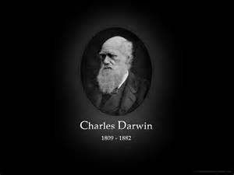
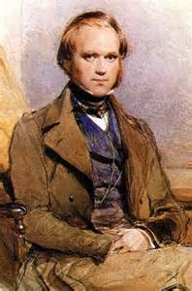
Scientific Study of the Islands
Much of what we know about scientific study and how it is done, is a result of the work done by scientists
For example, Charles Darwin who visited the Galapagos Islands in 1835

Slide 3
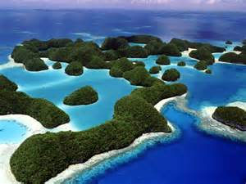
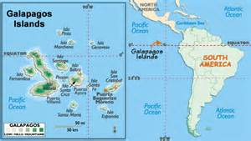
Galapagos Islands
Climate
Tropical
Varying; rain is scarce
Seasons are Mild(72 -78 degrees year round)
Wet and hot: December –May
Dry and cold: June-November
Plants have adapted to desert-like conditions creating a lush landscape.
Animals are very diverse

Slide 4
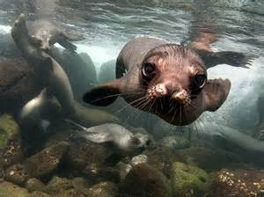
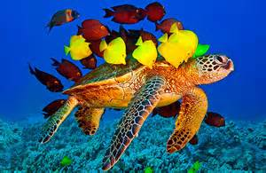
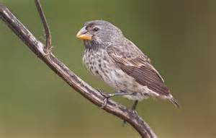
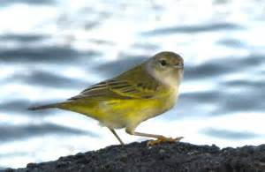
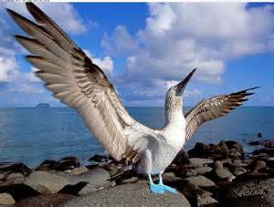
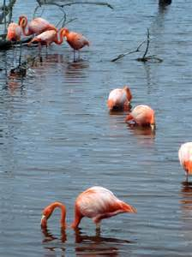
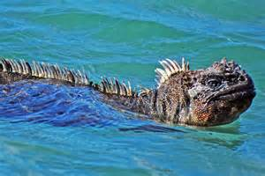
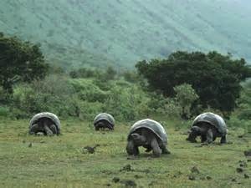
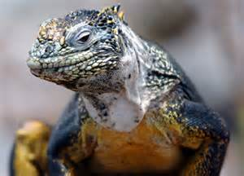
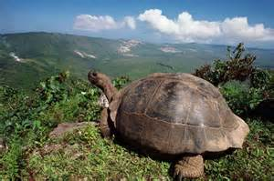
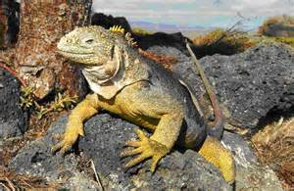
Diversity of Life on the Islands

Slide 5
What is Science? Science is a way of knowing
Scientists use models, themes, laws, mechanisms and theories to explain natural phenomena
Scientific knowledge assumes an order and consistency in nature
Hw: Read excerpt from Jonathan Weiner’s 1994 book The Beak of the Finsh and background information on Galapagos Finch species.

