Slide 1
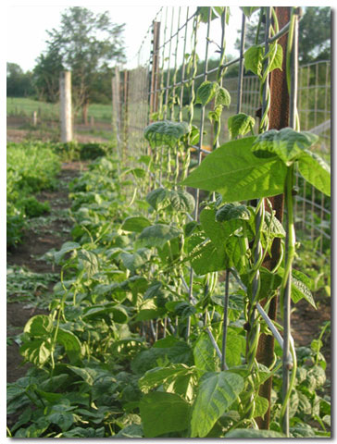
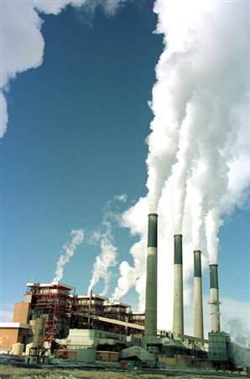
Cycles of Matter

Slide 2
The Water Cycle
The continuous process by which water moves from the Earth’s surface to the atmosphere and back.
It uses the process of:
Evaporation (liquid to gas)
Condensation (gas to liquid)
Precipitation (water vapor falls to Earth)

Slide 3
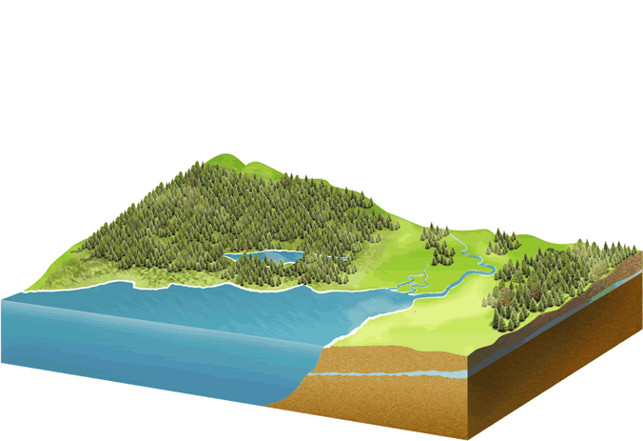
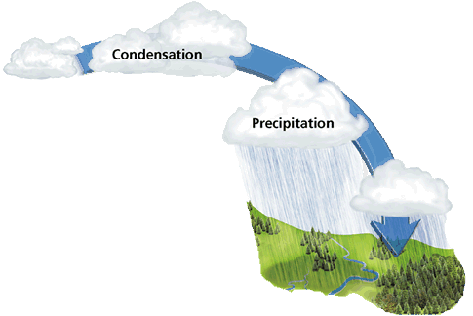
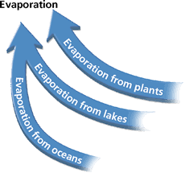
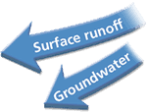

Slide 4
The Carbon Cycle
Carbon and oxygen are recycled.
Producers, consumers and decomposers all play a role in this cycle.
6CO₂ + 6 H₂O C₆H₁₂O₆ + 6 O₂
Plants and Consumers are dependent on each other!

Slide 5
The Carbon Cycle
Producers take in carbon dioxide and give off oxygen. (consumers are opposite).
Consumers eat producers (taking in carbon-food molecules) and release them as carbon dioxide and carbon waste products.
Decomposers break down the remains of producers and consumers and return it to the soil. They also release carbon dioxide.

Slide 6
The Carbon Cycle
Producers take in carbon dioxide and give off oxygen. (consumers are opposite)
Most organisms take in oxygen and give off carbon dioxide.

Slide 7
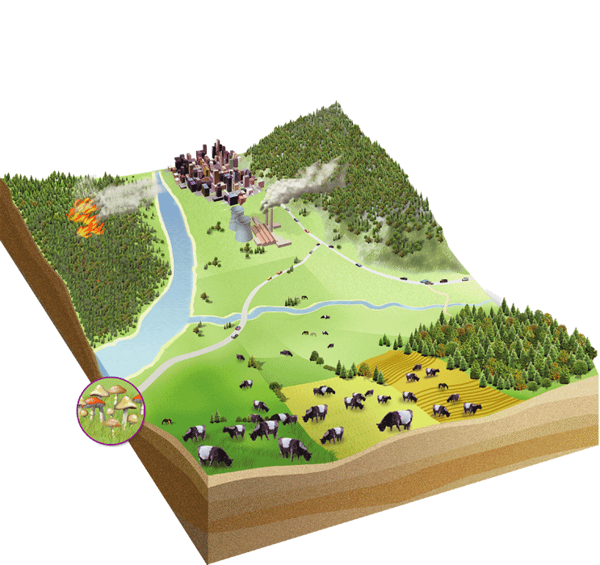
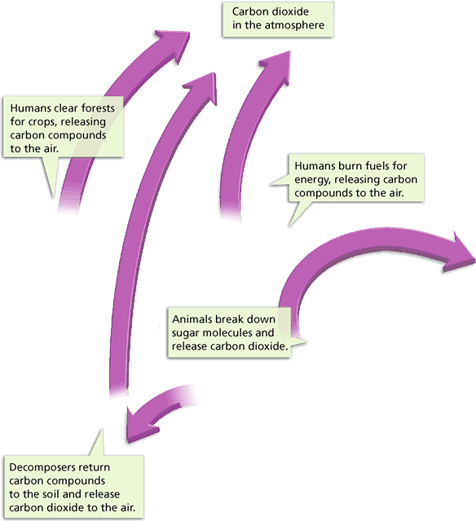
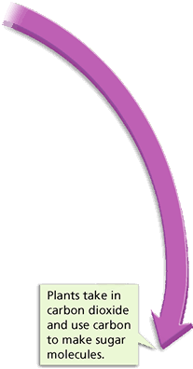
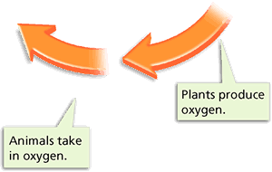
Carbon (purple) and Oxygen (orange) Cycle

Slide 8
The Human Impact
Humans affect the amount of carbon dioxide in the atmosphere:
Burning oil and other fossil fuels
Clearing forests for lumber
Burning down trees to clear a forest
Factories give off carbon dioxide

Slide 9
The Nitrogen Cycle
Nitrogen moves from the air to the soil, into living things, and back into the air.
Nitrogen gas is plentiful in the atmosphere (78%) but cannot be used until it is “fixed”.
Most nitrogen is fixed by bacteria.
They change free N to useable N.

Slide 10
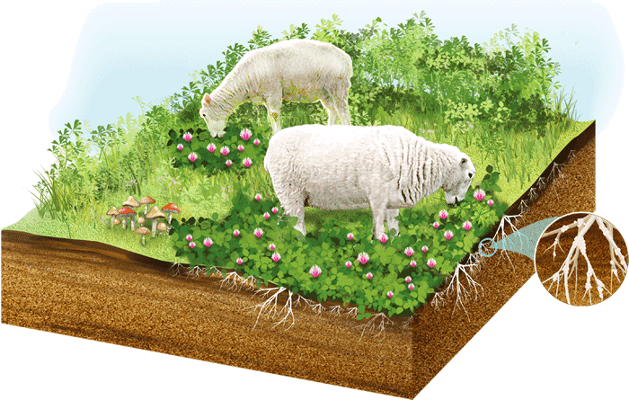
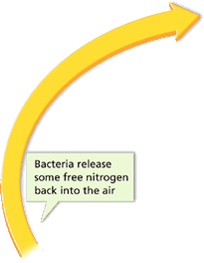
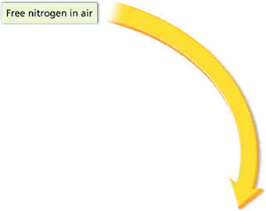
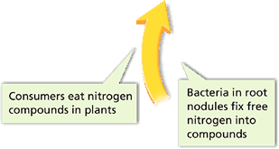
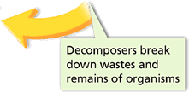

Slide 11
The Release of Nitrogen
Producers use Nitrogen to build proteins and other compounds.
Decomposers can break down waste (including animal waste) and return it to the atmosphere.
Nitrogen fixing bacteria can live on the roots of legumes, such as peanuts and beans.

Slide 12
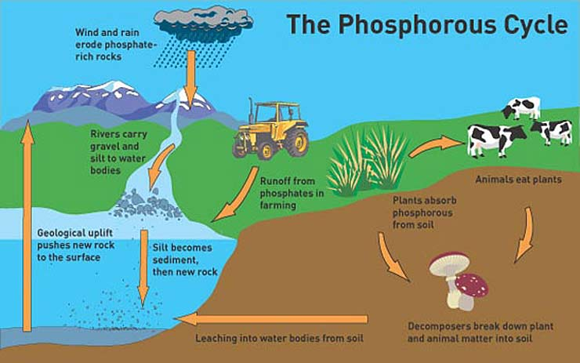

Slide 13
The Phosphorus Cycle
Sedimentary cycle (unlike Carbon, water and nitrogen cycles)
Phosphorus enters the biosphere through soil through weathering of rocks and absorption up the roots of plants
Used by organisms for energy (ATP) and to make nucleic acids (DNA and RNA)

