Slide 1
Cellular Respiration

Slide 2
Cellular Respiration

Slide 6
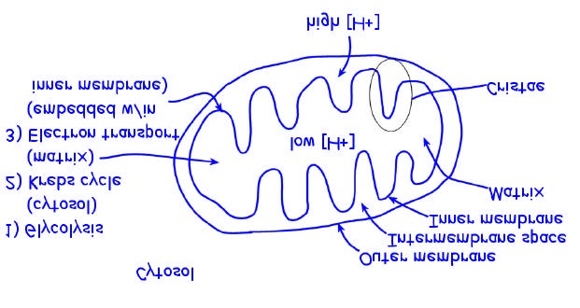
STRUCTURE OF MITOCHONDRION

Slide 21
Notes:
ETC accepts e - from NADH & FADH ₂
ETC passes e- to various molecules in chain
When some ETC molecules accept e- must also accept H+
H+ released to opposite side of membrane when e- passed to next molecule
High [H+] established in intermembrane space
e- accepted by O₂ forming H₂O
Channel protein allows H+ to move down conc. gradient
ATP synthase uses KE of H+ to add P_{i} to ADP forming ATP

Slide 22
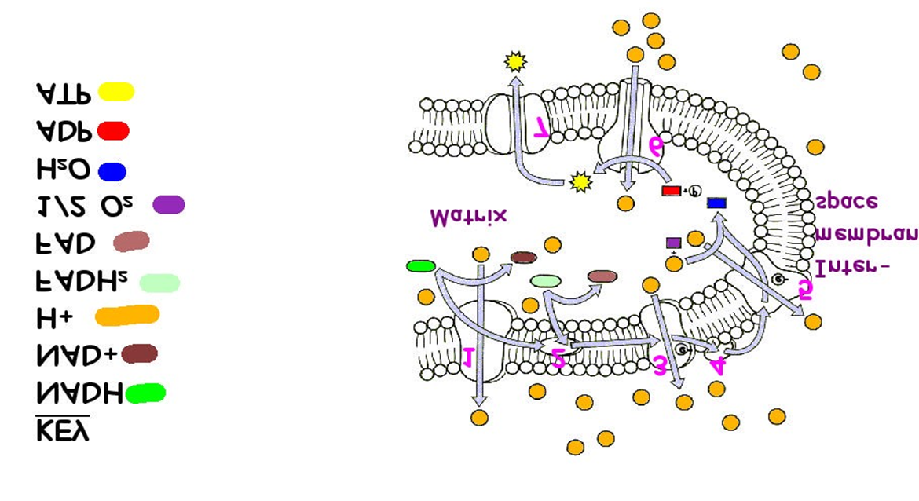

Slide 23
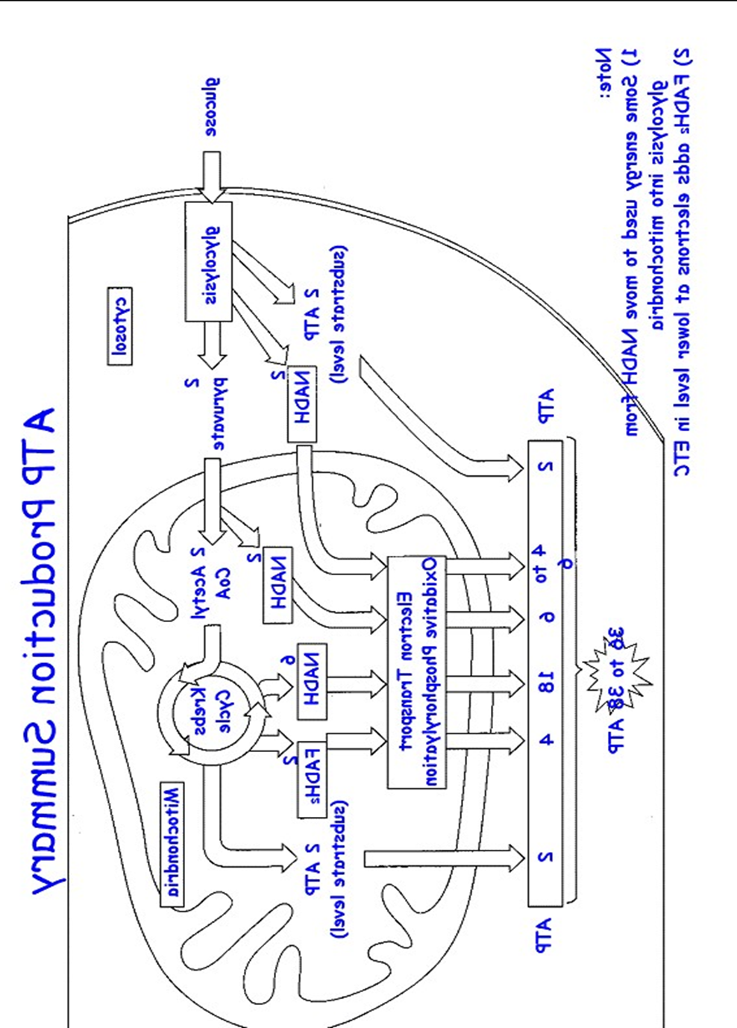

Slide 25
LACTIC ACID FERMENTATION
2
ADP
2
ATP
+2
P
2
Pyruvate
Glucose
Glycolysis
2
NAD
2NADH
+
2
lactate (ionized form of lactic acid)

