Slide 1
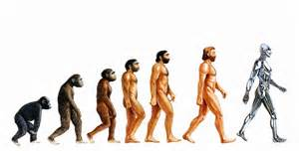
Evolution
Part 2

Slide 2
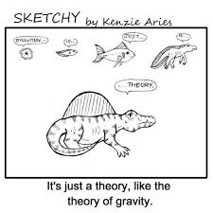
Scientific theory
Correct meaning of the word theory:
A substantiated explanation of some aspect of the natural world, based on a body of facts that have been repeatedly confirmed through observation and experiment and the science community validates each theory before it is accepted.
If new evidence is discovered that the theory does not accommodate, the theory is generally modified in light of this new evidence.

Slide 3
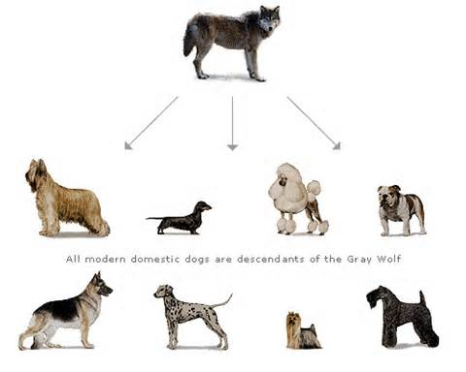
Darwin’s Theory of Evolution
Evolution
=the process of change over time

Slide 4
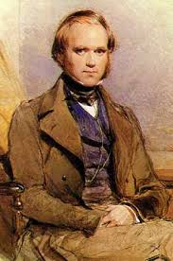
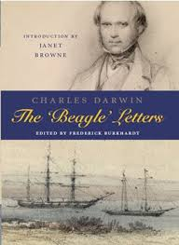
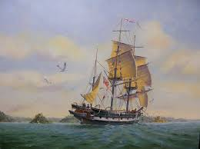
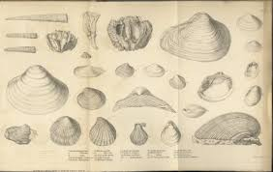
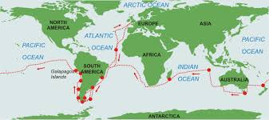
In Darwin’s travels aboard the HMS Beagle, which began in 1831, he made three important observations
The world includes a tremendous diversity of living things throughout a wide range of habitats.
Animals like those in the Galapagos islands that are related, can have different characteristics or occupy different habitats in the same area.
Fossils-or preserved remains of ancient organisms, resembled many organisms alive today

Slide 5
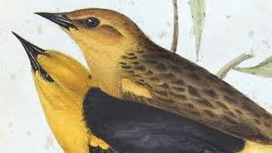
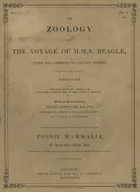
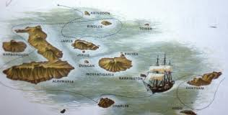
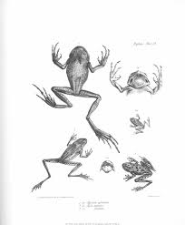
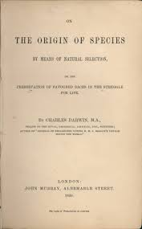
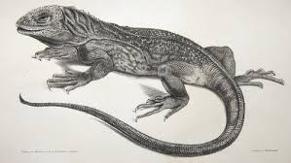
Darwin’s observations led him to develop the scientific theory of evolution which explains how modern organisms evolved over long periods of time by natural selection

Slide 6
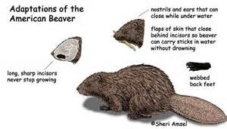
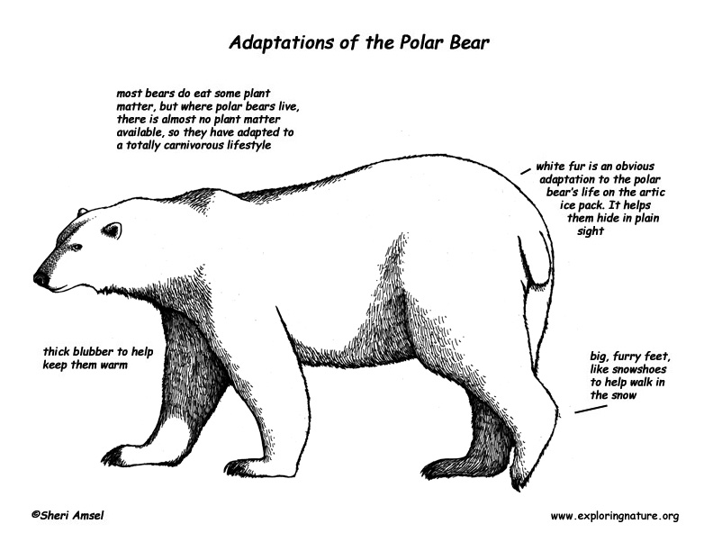
Adaptation
A trait that helps an organisms survive and reproduce
Also means that the distribution of traits in a population can change when conditions change

Slide 7
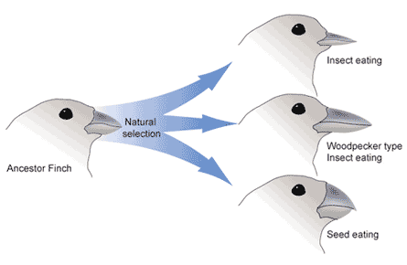
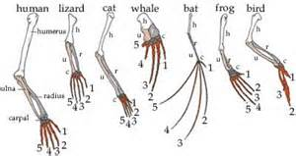
Natural Selection
Process by which individuals are better adapted to their environment are more likely to survive and reproduce than other members of the same species
Factors that affect process of natural selection:
Overproduction-species produce more offspring than can survive (insects, fish…)
Variations-differences between individuals
Competition-resources are limited, species must compete to survive.

Slide 9
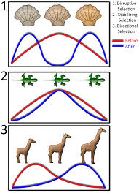
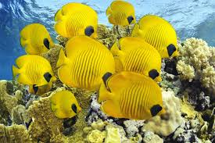
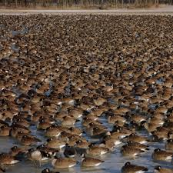
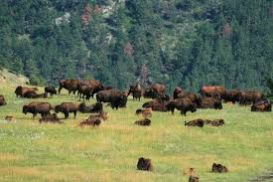
Evolution is the consequence of four factors
1. the potential for a species to increase in number

Slide 10
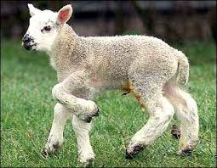
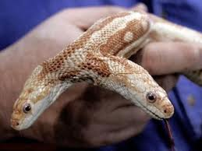
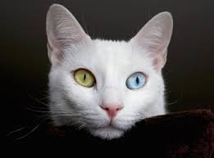
2. the genetic variation of individuals in a species due to mutation and sexual reproduction

Slide 11
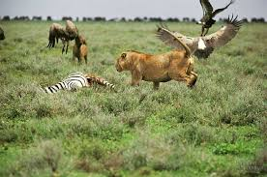
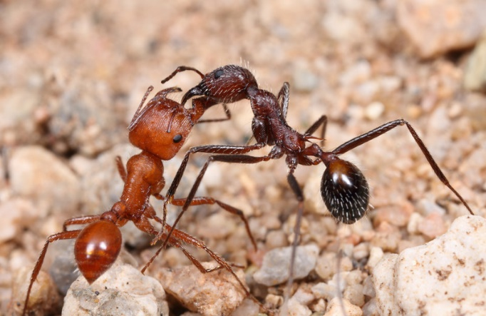
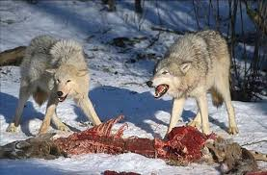
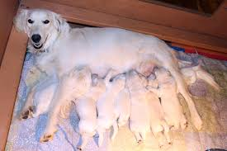
3. competition for an environments limited supply of the resources that individuals need in order to survive and reproduce

Slide 12
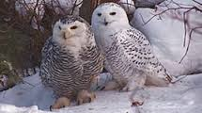
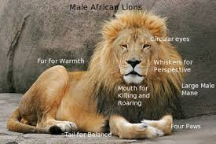
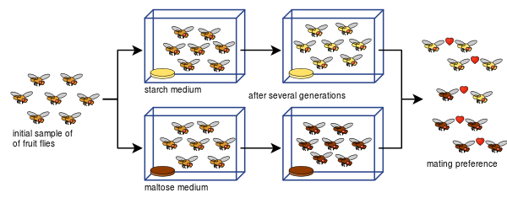
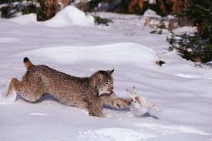
4. the ensuing proliferation of those organisms that are better able to survive and reproduce in that environment

Slide 13
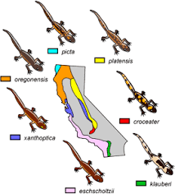
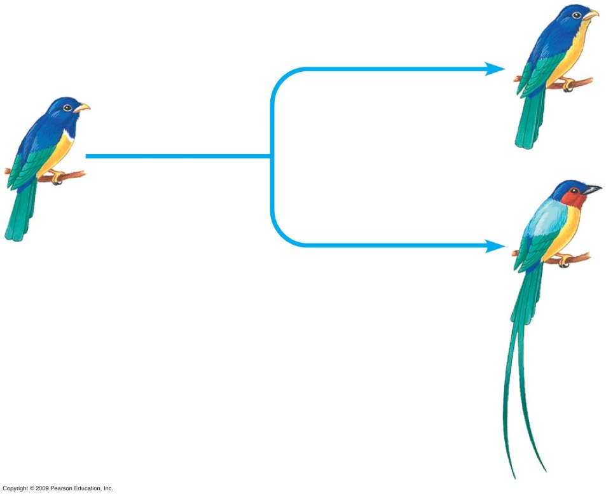
Speciation and the environment
Speciation
Expansion of new species
Populations no longer can interbreed

Slide 14
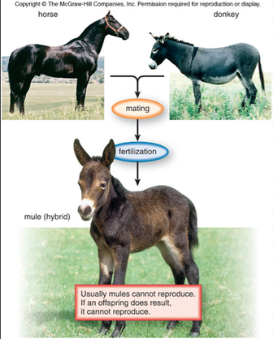
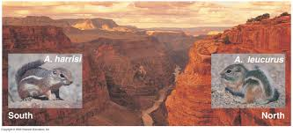
Changes in the physical environment, either naturally or human-induced, contribute to the expansion of some species, the emergence of new species and the decline-and sometimes extinction-of some species

Slide 15
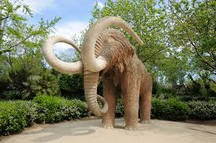
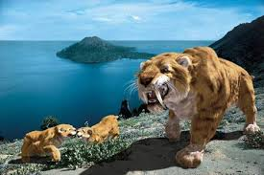
Species become extinct because they can no longer survive and reproduce in their altered environment. If members cannot adjust to change that is too fast or drastic, the opportunity for species’ evolution is lost.

Slide 16
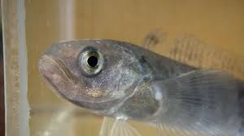
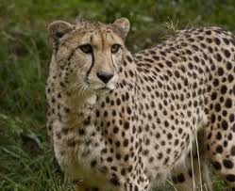
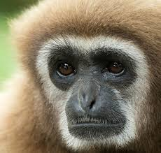
Birth and Death of Genes Notes and Discussion Questions/answers

Slide 17
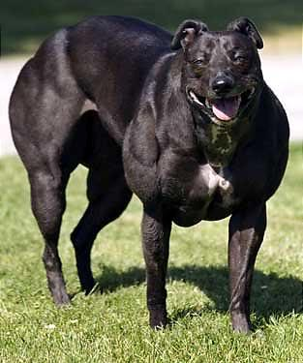
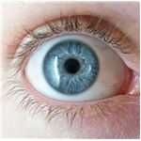
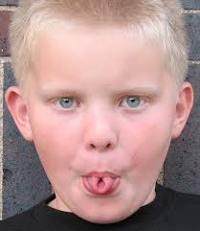
Key Points
Traits (characteristics) are determined by genes
Genetic changes can happen randomly
Genes and traits are inherited and some traits give organisms a greater chance of survival and reproduction.

Slide 18
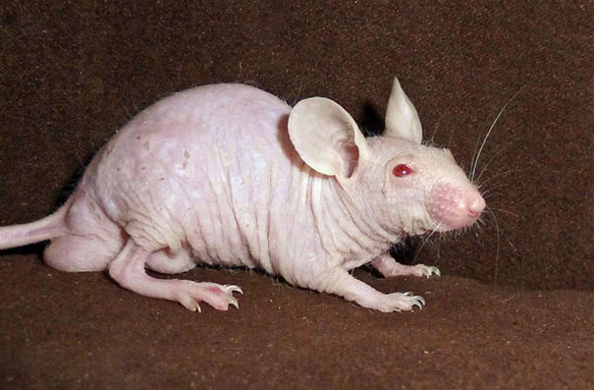
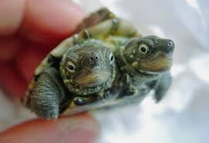
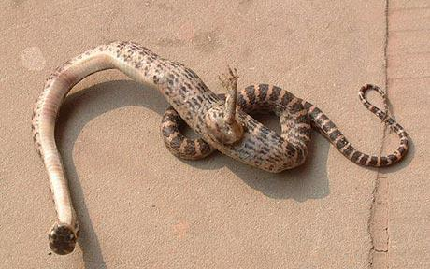
Mutations can result in both the appearance of new genes and the loss of existing genes
Changes in the environment where a population lives can change which traits (and therefore genes) are favorable
The frequency of an allele (form of gene (dominant or recessive)) in a population can change depending on whether it is advantageous, deleterious, or neutral.
Notes:
Okay, it’s still weird, but the basic explanation is pretty simple: a mutation of some sort has snake from China found with claw sticking out of body….mutation caused the snake to manifest traits associated with a genes that have been long dormant and were inherited from the past ancestors of the snake which did have legs. Two headed turtle, hairless rat (selective breeding)

Slide 19
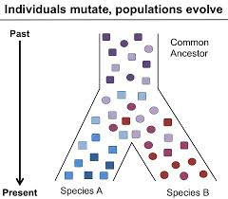
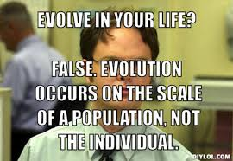
Populations evolve over time; Individuals DO NOT evolve in their lifetimes.
One way that a new gene can arise is when a gene is duplicated and one copy (or both copies) of the gene accumulates mutations, which change the function of the gene.
One way that a gene can be lost is when one or more mutations accumulate that destroy its function.

Slide 20
Review
Mutation is random. Selection, however, depends on the environment
icefish provide an example of how both the birth (evolution of antifreeze proteins) and death (loss of hemoglobin) of genes can have positive effects

Slide 21
Icefish Introduction
Icefish have adaption that help them thrive in icy, food-rich Antarctica waters. The birth and death of genes have been critical in these adaptations.
Scientists have pinpointed genetic changes that enable icefish to survive without red blood cells and use antifreeze proteins in the ice-cold ocean climate.

Slide 22
Discussion Question after film
What do you think Dr. Sean B. Carroll meant when he stated, “Notothenioids invented antifreeze genes.”

Slide 23
Where did the Icefish antifreeze gene originate?
The gene responsible for the production of antifreeze proteins in notothenioids evolved from a trypsinogen gene through a series of mutations.
First, a chance duplication resulted in the production of an extra copy of the trypsinogen gene. Over time, in addition to mutations within the original trypsinogen coding region, a small piece of the gene that would eventually code for the antifreeze protein became amplified (copied many times). At the time these mutations were taking place, the ocean was warmer and the mutation neither helped nor harmed the notothenioids. As the temperature decreased, fish that happened to have the ability to produce antifreeze proteins would have survived and reproduced, thus passing the adaptation on to their offspring. Fish without the adaptation would not have survived to reproduce.

Slide 24
Answer
Icefish did not actually “invent” the antifreeze gene in the sense that they created it.
Organisms do not adapt to environmental changes through conscious design.
Adaptations are the result of random mutations that are acted upon by selective forces.
Icefish did not invent antifreeze so that they could live in cold waters. In fact, the antifreeze gene evolved before the ocean’s temperature dropped below the freezing point of fish blood.
The use of the word “invention” is good in terms of telling a story but not accurate in the scientific sense.

Slide 25
Evolving Switches, Evolving bodies Notes, Discussion, questions and Answers.

Slide 26
Introduction
The bodies of three spine stickleback fish in certain populations evolved as they adapted from living in the ocean to a life exclusively in freshwater environments.
One adaptation was the loss of pelvic spines, which are homologous to the hind limbs of four-legged animals.
Scientists have determined that changes to the stickleback pelvis are largely due to changes in a particular gene regulatory switch, a stretch of noncoding DNA sequence that functions to turn genes on or off.
Mutations in gene switches that control developmental genes are an important evolutionary mechanism responsible for the diversity of animal forms.

Slide 27
Dramatic changes in traits can occur through mutation in a small number of genes, or even a single gene.
Different environments can provide different selective pressures on organisms structure.
In the stickleback, pelvic spines provide a selective advantage in environments with large predatory fish, but are a liability in environments with dragonfly larvae.

Slide 28
All the cells of the body contain the same genes, but only a subset of those genes is active in any particular cell type. For example, liver cells express a different set of genes than muscle cells.
The expression of genes that control development—the process by which a fertilized egg divides, grows, and develops into an adult—is regulated by genetic elements called switches. Switches determine at which times during development and in which cells or tissues a particular gene is turned on or off.

Slide 29
Mutations that alter the function of a genetic switch can affect when and where a gene is expressed without affecting that gene’s protein product. Thus, a mutation in a genetic switch that regulates the expression of the Pitx1 gene in the pelvis will not affect the gene’s expression and protein product in other parts of the body.

Slide 30
Evolutionary change can occur rapidly from a geological perspective—typically measured in millions of years—if the environment strongly favors or disfavors a particular trait. In the case of freshwater stickleback populations in North America, the loss or reduction of pelvic spines evolved within the past 10,000 years.

Slide 31
Similar evolutionary adaptations can occur independently in different populations that have similar selective pressures, and in some cases may result from the same genetic mechanism. For example, pelvic reduction occurred in separate freshwater stickleback populations due to mutations in the same genetic switch. Below is another example.

Slide 32
The evolution of anatomical traits can be studied by carefully measuring and comparing related populations living in different habitats, by comparing the DNA of individuals with similar and different traits, and by analyzing the same trait in related species found in the fossil record. It is possible to use all three approaches to study the evolution of pelvic reduction in the stickleback.

Slide 33
Fossil Record Notes, discussion, questions.
This should be review from previous coursework.

Slide 34
The Fossil Record
Paleontologists
Scientists who study fossils, or the preserved remains or traces of organisms that lived in the past
Fossil Record
Collection of fossils organized to provide evidence about history of life on Earth, including how organisms have changed over time

Slide 35
The formation of fossils are rare events, but can occur by
Petrified fossils
Remains are buried in sediment, then change to rock over time-now called a petrified fossil
Molds and Casts
Hollow space in sediment in the shape of an organism is called a mold; when a mold becomes filled with hardened minerals it becomes a cast.
Preserved remains
Quickly buried organisms are buried in ice, volcanic ash or clay before they begin to decay.

Slide 36
Relative Dating vs. Radioactive Dating of Fossils

Slide 37
Relative Dating
Age of fossils are determined by comparing its placement with that of fossils in other layers of rock

Slide 38
Radioactive Dating
Involves measuring the amounts of radioactive isotopes in a sample to determine its actual age

Slide 39
Paleontologists
Use the geological time scale, or a “calendar” of Earth’s history to represent evolutionary time
After Precambrian time, the geological time scale is divided into eras (Paleozoic, Mesozoic, and Cenozoic) and these eras are subdivided into periods, which range in length from tens of millions of years to less than two million years.

Slide 40
Classification Notes, discussion, questions.

Slide 41
Classification
In the 1730’s, Carolus Linnaeus, a Swedish botanist, developed a two-word naming system called binomial nomenclature-first part of name is genus and second part of name referring to species
Linnaeus also developed a classification system which included seven hierarchical taxa:
Kingdom, Phylum, Class, Order, Family, Genus, Species
Ex. Grizzly Bear
Animalia, Chordata, Mammalia, Carnivora, Ursidae, Ursus, arctos

Slide 42
Sometimes classification keys are used to identify organisms by traits that are visible, however scientists today now look at how closely members of groups are related.

Slide 43
Phylogeny
Study of how living and extinct organisms are related to one another

Slide 44
Clade
Group of species that includes a single common ancestor and all descendants of that ancestor

Slide 45
Cladogram
A diagram that links groups of organisms by showing how evolutionary lines, or lineages, branched off from common ancestors
c
d
b
a
Descendants
Splitting Events
Ancestral linage

Slide 46
Derived character
Trait that arose in the most recent common ancestor of a particular lineage and passed to it’s descendants

Slide 47
Transitional Fossils: Tetrapods. Notes, discussion, questions

Slide 48
Introduction
The discovery of Tiktaalik, a fossil with a mix of features common to fish and four-legged animals (tetrapods), is one of the most exciting adventures in the long history of fossil exploration. Tiktaalik, along with other transitional fossils, illuminates the key evolutionary steps that groups of animals took as they moved from water to land.

Slide 49
Key Concepts
Species descend from other species. Even distantly related species, like humans and sponges, can trace their shared ancestry back to a common ancestor.

Slide 50
The fossil record provides a history of life on Earth. It includes fossils with features that are intermediate, or transitional, between those of major groups of animals.

Slide 51
When a series of transitional fossils are viewed together, they reveal the gradual sequence of change connecting one major group to another.

Slide 52
Evidence that land vertebrates descended from fish includes transitional fossils, anatomical similarities among embryos and adult animals, and genetic evidence of common ancestry.

Slide 53
The limbs of mammals, amphibians, reptiles, and birds look different, but they are all built on a shared basic arrangement of “one bone, two bones, many bones, and digits.”

Slide 54
To find fossils, scientists develop hypotheses about the types of habitats in which earlier animals lived and why they lived there. They then predict which types and ages of rocks would house fossils of those animals.

Slide 55
Discussion

Slide 56
Is finding fossils due to luck or ?
Paleontologists do not accidentally stumble upon the fossils they discover, but that paleontology is a process of hypothesis testing. Through careful planning, reading scientific articles, and studying geology and geological time, paleontologists form hypotheses about the time periods and habitats occupied by certain organisms. They then develop predictions about what kinds of rocks certain fossils of those organisms should be buried within and where rocks of those types and ages are found on Earth.

Slide 57
Why don’t we find more fossils?
Consider a mouse that is running near the school at this very moment. Consider the probability that that single mouse will die today, become fossilized, and be rediscovered a million years from now. The probability is nearly zero.
To become fossilized, the mouse must not be eaten right after it dies and not decompose within a few days. Instead, the mouse’s body must be quickly and completely buried in either volcanic ash or some kind of sediment. It must remain buried until the sediment and the mouse remains turn into rock—a process that may take thousands or even millions of years.
Enough time has passed in Earth’s history for some individuals, from the hundreds of thousands within any one species, to have been in the right conditions to become fossilized.

Slide 58
Have you ever thought something like….”If we evolved from fish, why are there still fish?”
Humans and modern-day fish share a common ancestor that no longer exists. The aquatic habitats in which fish thrive today have been around for over half a billion years, and fish are well adapted to live in those environments. When some fish populations evolved stronger, limblike structures in fins, they were able to exploit new types of habitats and reduce competition with other fish for resources. But fish continue to exist because there are still environments in which fish can thrive.

Slide 59
What advantages do you think a neck might provide?
The lack of bones connecting head to body provides flexibility to move the head without moving the rest of the body. A flexible neck could have been beneficial in many possible scenarios. However, this flexibility may have also come at a cost—for example, the loss of the protective gill cover. We don’t know exactly how Tiktaalik used its neck.

Slide 60
Other Transitions from earlier to later forms?
Rich fossil evidence supports:
Evolution of whales from terrestrial mammals
Fun fact: Whales flex their backbones up and down like a Cheetah (not side-to-side like a swimming fish)
Evolution of birds from dinosaurs

Slide 61
Why is the term “missing link” inaccurate?
It is used incorrectly to imply that an unbroken chain of organisms is required to demonstrate that all species are related.
The terms transitional form or transitional fossil more accurately describe species that illustrate the sequence of changes that occurred during the evolution of new groups of organisms.

Slide 62
Is Tiktaalik our ancestor?
It is a representative of an animal that was an ancestor to modern tetrapods, including humans.
We can’t say it is a direct anscestor.
Fossils, like Tiktaalik, may be direct ancestors, but they are much more likely representative of what actual ancestors liked like and not the ancestors themselves.
The descendants of Tiktaalik went extinct a long time ago, but other related are yet to be discovered and may be a common ancestor to all modern tetrapods. We may never now, but we can be certain that the ancestor looked a lot like Tiktaalik.

Slide 63
How do fossil animals like Tiktaalik that lived in warm habitats, end up in the Canadian Arctic Islands?
Earth’s crust is dynamic
Plate tectonics move land masses, and fossils that were once at the equator can be moved to distant locations

